Slide 1
Project Studies Presentation
Setting up a private blockchain network
Soorya Kuppusamy
Jérémie Djaoud-Deshayes
30th of January, 2024

Slide 2
Agenda
01
Introduction
How does a private blockchain work?
02
Demo on private blockchain setup & interaction between nodes
03
Benefits of using private blockchain over public blockchain
04

Slide 3
Private Blockchain
Access
Authority
Single organization.
Partially decentralized.
Transaction Speed
Consensus
Fast.
Permissioned (Proof-of-Authority)
Efficiency
Immutability
High.
Partial.

Slide 4
Benefits of blockchain
A
Since there’s no central authority to oversee operations, the blockchain is an ideal register for joint business ventures.
The digital signature and verification process used in blockchains helps prevent fraudulent activities.
B
C
Information isn’t centralized, preventing it from being lost (Distributed ledger).
D
Faster transaction speed.

Slide 5
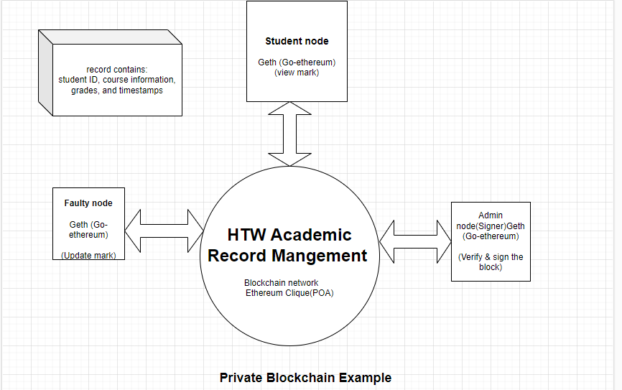

Slide 6
Consensus Mechanism: Clique
Proof-of-Authority (PoA)
In a PoA consensus algorithm, a set of trusted nodes known as authorities, each identified by their unique identifier, are responsible for mining and validating the blocks in the blockchain.
Each block is produced by an authority at a fixed interval.
The responsibility of creating the next block is shared among the set of authorities and is done in a “round-robin fashion”. This rotation ensures fairness and prevents any single sealer from having undue influence for an extended period.
The signers collect and execute the transactions from the network into a block and update the world state. At the fixed interval referred to as the BLOCK_PERIOD, the next signer in the list (identified by BLOCK_NUMBER % SIGNER_COUNT) calculates the hash of the block and then signs the block using its private key (sealing the block). It then broadcasts the sealed block to all nodes in the network.
The protocol also defines a voting mechanism to dynamically add new signers and remove existing ones. In Geth this can be controlled via the clique.Propose(address, authorized) method.
When the total number of votes is equal to or greater than FLOOR(SIGNER_COUNT / 2) + 1, the action to add or drop is honored.
The field difficulty is set to a value of 2 if the block is sealed by the in-order signer (referred to as DIFF_INTURN). Else, is set to a value of 1 if the block is sealed by an out-of-order signer.

Slide 7
The need for an out-of-order signer arises in scenarios where the regular in-order signer is unavailable or encounters issues. For example, if the in-order signer is down for any reason, a block would be missed after the fixed period of BLOCK_PERIOD. In such cases, the remaining out-of-order signers will introduce a random delay of (SIGNER_COUNT * 500) ms, and the first out-of-order signer to surpass this delay will then seal the next block. This mechanism ensures continuity in block generation even when the in-order signer is temporarily unavailable.
To make block sealing successful:
at least 51% of the signer nodes must be up and running, and they should also be connected to the network.

Slide 8
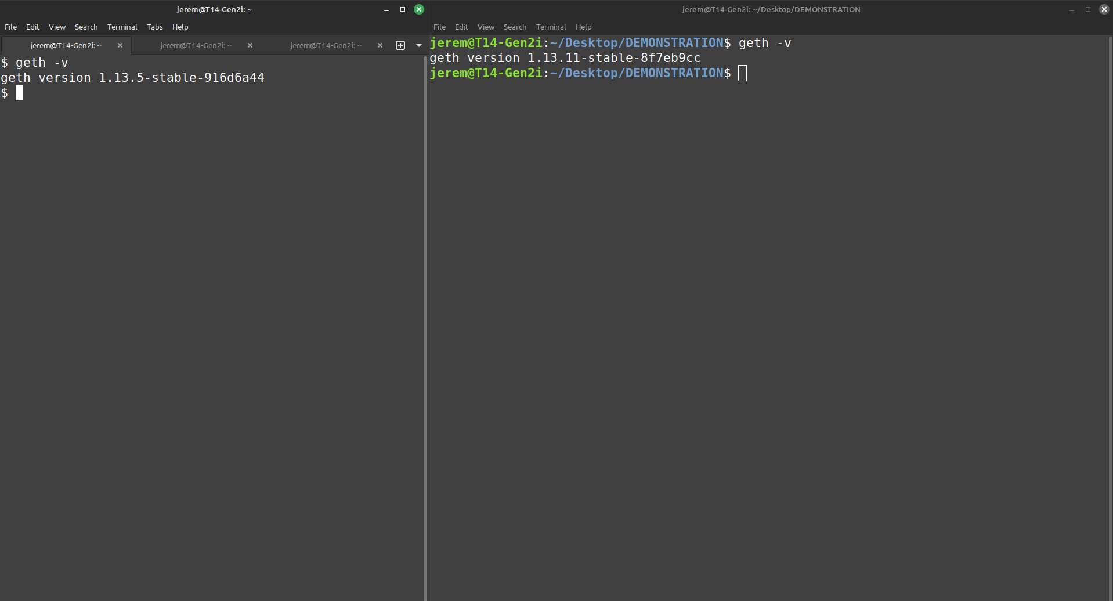
1. Check that the Geth client is installed:
Command:
geth -v
Remote server:
Connection via SSH
IP: 141.45.212.243
Local machine

Slide 9
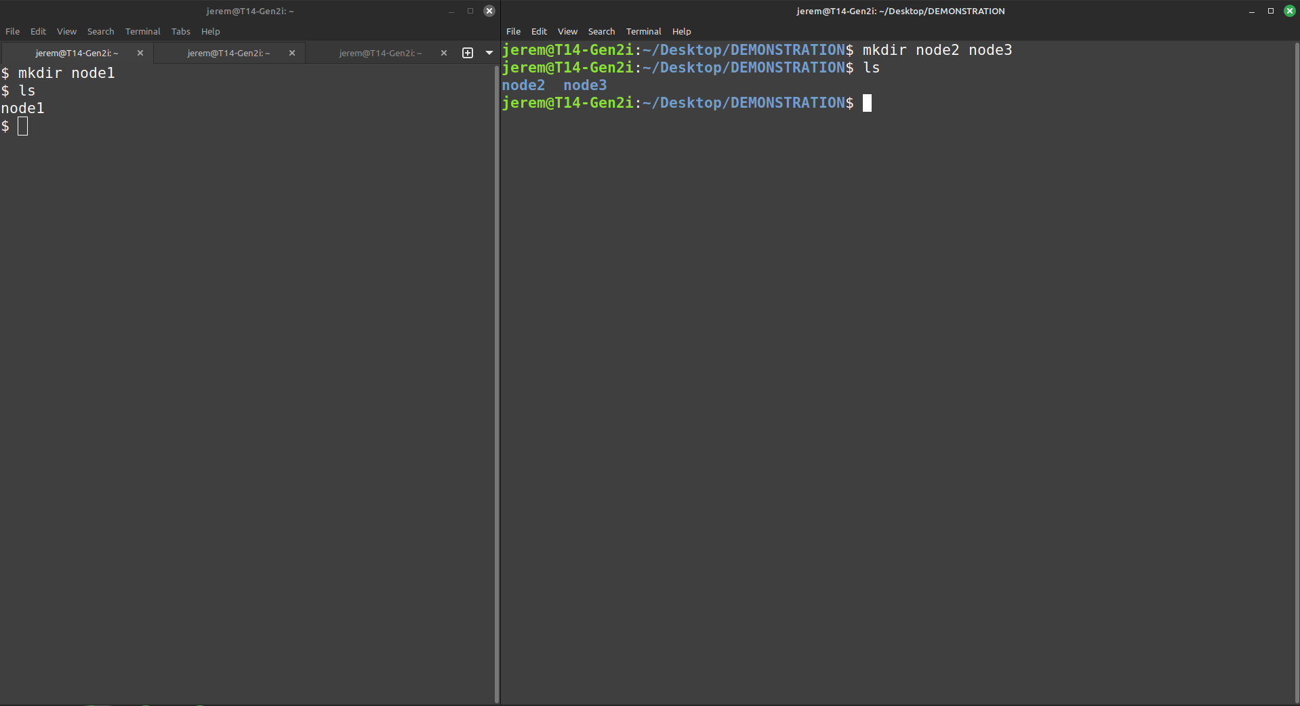
2. Create nodes directories
For this example, we are creating 3 separate nodes.
Commands:
mkdir node1 (on the server)
mkdir node2 node3 (locally)
Remote server
Local machine

Slide 10
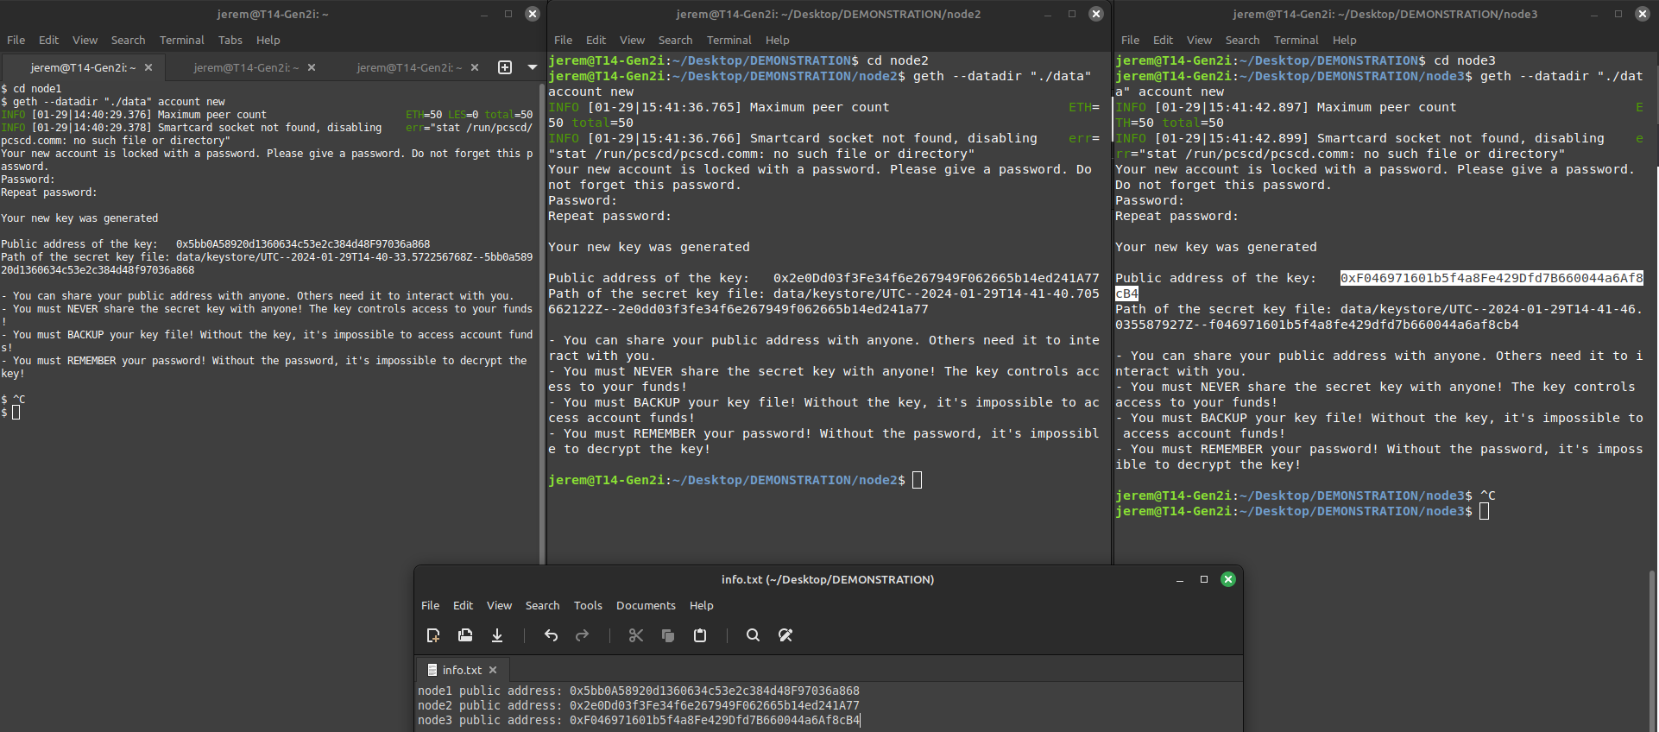
3. Create 1 account per node
In our example, we are creating 1 individual account per node, but we could create as much as we want.
Command:
geth –datadir “./data” account new
This command will prompt us to enter a password; we used “1234” for the three nodes for demonstation purposes.
It will output the public address of each account as well as the path to their private keyfiles.
It will create a “datadir” that we called “data” for this example, that will contain the info related to the accounts existing on this node.
node1 (remote)
We save the public addresses of these accounts in a separate text file (info.txt).
node2 (local)
node3 (local)

Slide 11
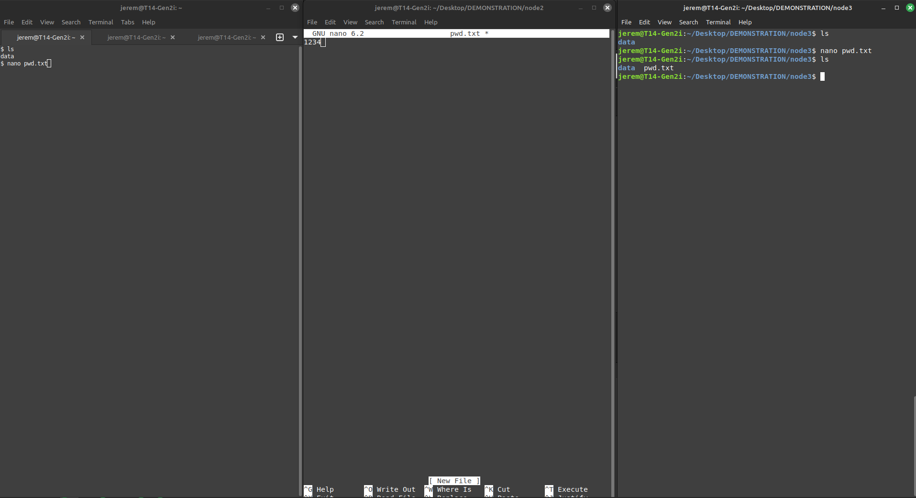
4. Save password in a new file (pwd.txt)
We need to save the passwords of each accounts in a text file as we will use them to “unlock” these accounts later.
Commands:
- nano pwd.txt
- Enter the password set (1234)
- Save the file in the node folder (next to the “data” directory)
node1
node2
node3

Slide 12
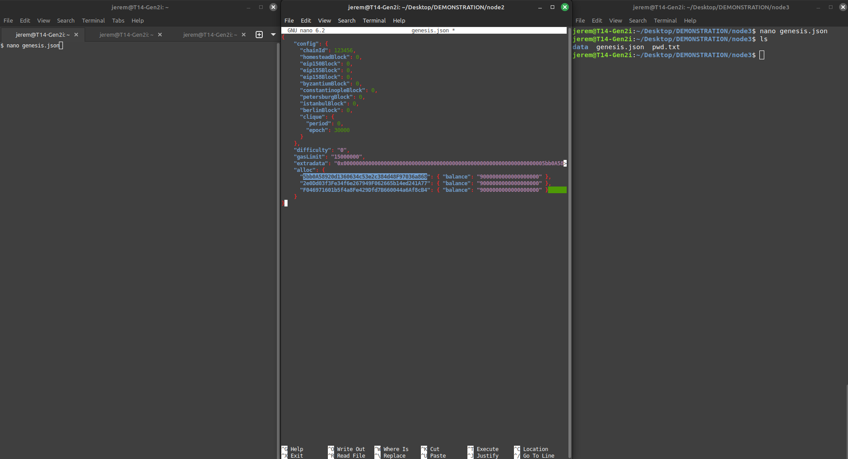
5. Create the Genesis block configuration in each node folder
Now, we’re going to create and configure the “Genesis” block of our private blockchain, which will define the initial configuration of our network.
Commands:
- nano genesis.json
- Paste your genesis block configuration
- Save the file in the node folder (next to the “data” directory and the “pwd.txt” file)
node1
node2
node3

Slide 13
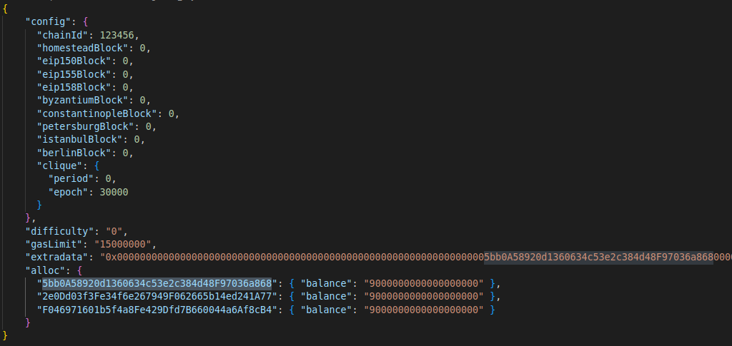
Details of the Genesis block:
Here is our configuration:
- chainId set to 123456.
- period set to 0 (meaning that new blocks will only be created when transactions are happening)
- epoch set to 30.000 (meaning that after every 30k blocks, a new set of validators will be chosen)
- difficulty set to 0 (meaning that the network will have a fixed, very low difficulty level to seal new blocks)
- gasLimit set to 15000000, mirroring approximately half of the actual Ethereum mainnet’s gas limit.
- extradata contains the address of node1 (excluding the leading 0x), meaning that it will be assigned as the signer node.
- alloc fields define an initial balance of 9 Ether to the 3 accounts we created (without the leading 0x) – an Ether being equal to 10^24 wei.

Slide 14
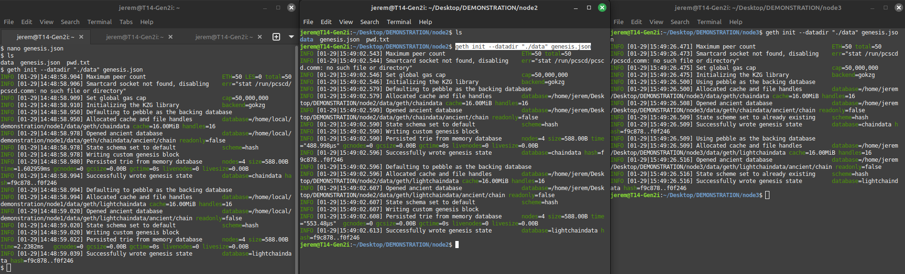
6. Initialize each node with the Genesis block configured
Now, we’re going to initalize our 3 nodes with the genesis.json block file previously created.
node1
node2
node3
Command: geth init –datadir “./data” genesis.json on each nodes
To make sure that the three nodes have been successfully initiated with the same Genesis block, we have to check the hash values that are returned; here, we can see that they correspond: hash=f9c878..f0f246, so the initialization was successful.

Slide 15
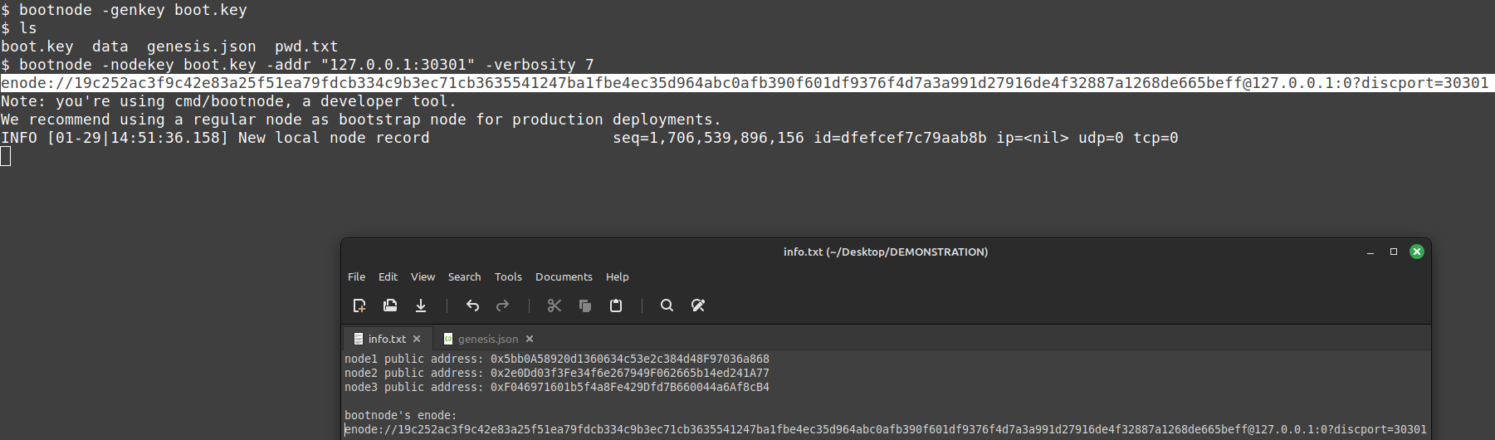
7. Start the bootnode
Next, we’re going to start a bootnode on node1 (the remote server):
node1
Commands:
- bootnode -genkey boot.key
- bootnode -nodekey boot.key -addr “127.0.0.1:30301” -verbosity 7
These commands will create a boot.key file, that will be used to start the bootnode, on the 127.0.0.1 address (localhost) under the port 30301, with a high level of verbosity to have comprehensive debug and logs in the console of this bootnode.
This will output an enode, that we save in our info.txt file as we will use it in the next step.

Slide 16
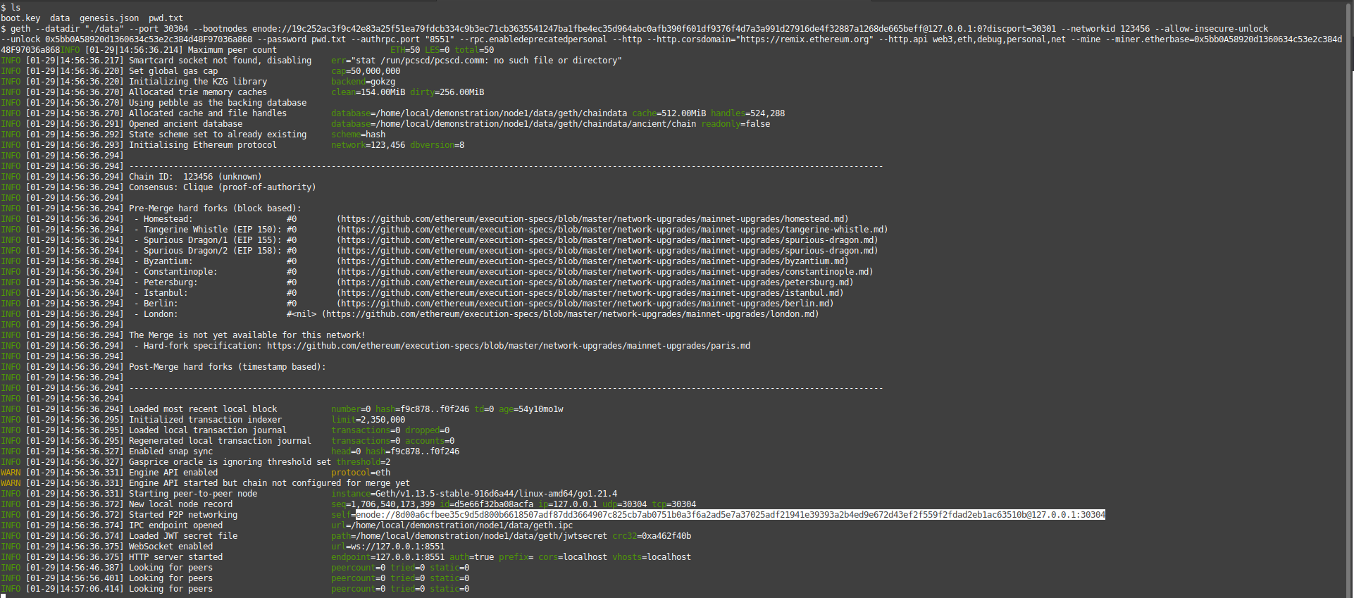
8. Start the first node (node1)
Now, in a new terminal window (still on the remote server in the node1 folder), we’re going to start the node1 by using the following command, referring to the enode of the bootnode created previously:
Command:
geth --datadir "./data" --port 30304 --bootnodes enode://19c252ac3f9c42e83a25f51ea79fdcb334c9b3ec71cb3635541247ba1fbe4ec35d964abc0afb390f601df9376f4d7a3a991d27916de4f32887a1268de665beff@127.0.0.1:0?discport=30301 --networkid 123456 --allow-insecure-unlock --unlock 0x5bb0A58920d1360634c53e2c384d48F97036a868 --password pwd.txt --authrpc.port "8551" --rpc.enabledeprecatedpersonal --http --http.corsdomain="https://remix.ethereum.org" --http.api web3,eth,debug,personal,net --mine --miner.etherbase=0x5bb0A58920d1360634c53e2c384d48F97036a868
This might look a bit complex, but what this does is basically starting node1 by connecting it to the bootnode’s enode, unlocking the account in node1 (providing the path to the pwd.txt file), and providing a couple of other arguments.
We save the outputted enode of this node1 in our info.txt file, as we will need it for next nodes to connect to it.
node1

Slide 17
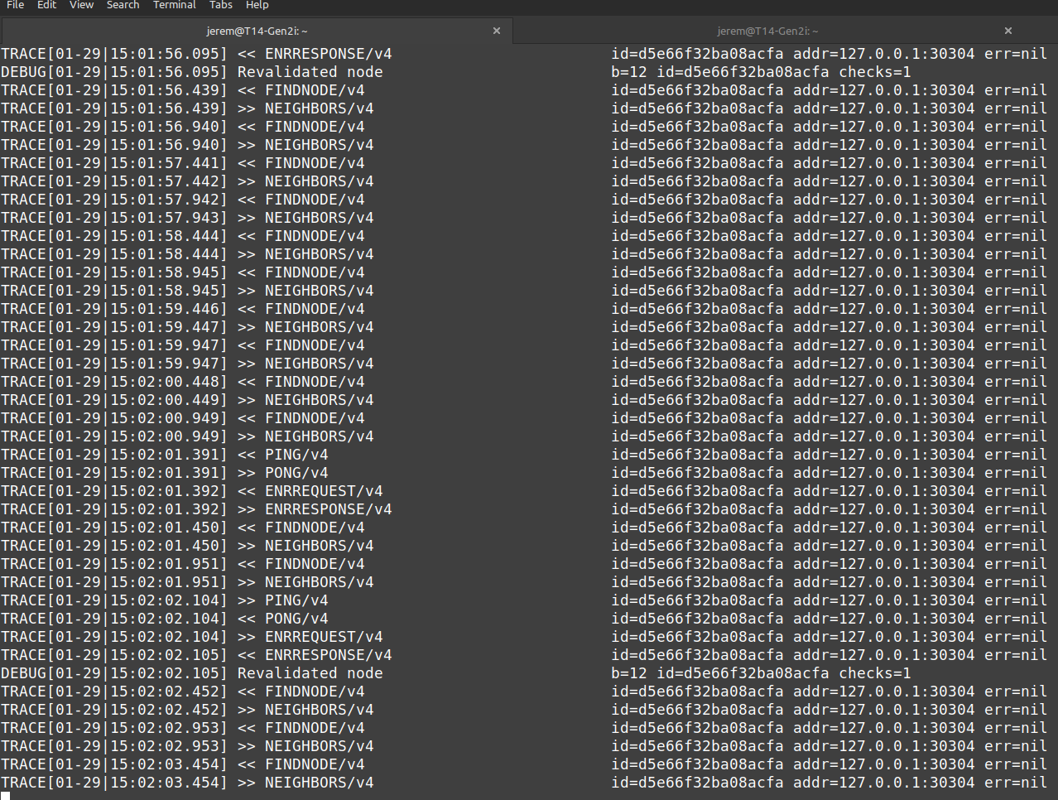
Check the bootnode status:
Coming back to our bootnode’s terminal window, we should now see that it is communicating with the node1 we just started:

Slide 18
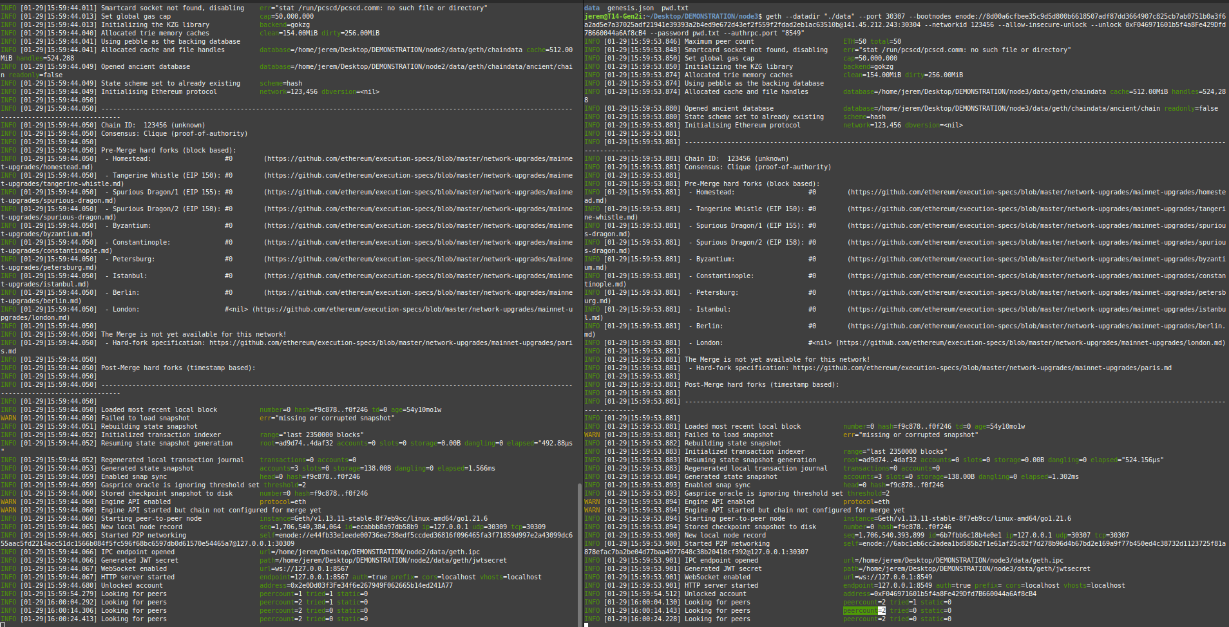
8. Start the two other nodes:
Coming back to our local machine(s), we’re now going to start node2 and node3, but being careful to replace the localhost IP address of node1’s enode by its actual public IP address (from 127.0.0.1:30304 to 141.45.212.243:30304)
Commands:
node2:
geth --datadir "./data" --port 30309 --bootnodes enode://8d00a6cfbee35c9d5d800b6618507adf87dd3664907c825cb7ab0751b0a3f6a2ad5e7a37025adf21941e39393a2b4ed9e672d43ef2f559f2fdad2eb1ac63510b@141.45.212.243:30304 --networkid 123456 --allow-insecure-unlock --unlock 0x2e0Dd03f3Fe34f6e267949F062665b14ed241A77 --password pwd.txt --authrpc.port "8567"
The command to start node3 is basically the same, but changing the port, unlock and authrpc.port flags.
Here’s how the output looks like: we can see, at the bottom, that the peercount is now equal to 2, which means that all of our three nodes are connected to two peers each.
node2
node3

Slide 19
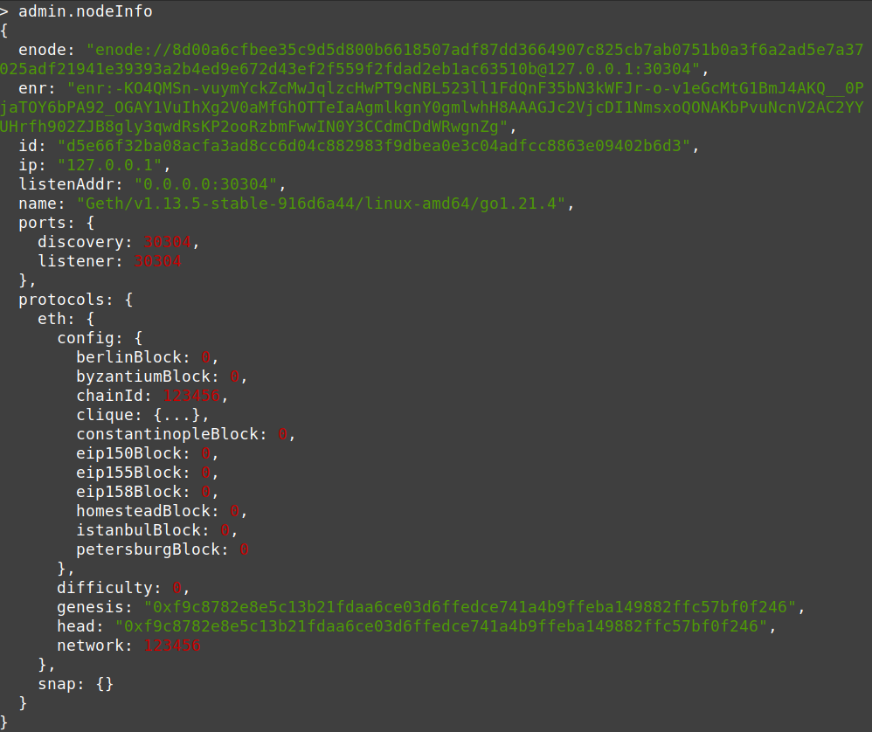
Check node1’s information:
From the node1 second terminal window, we can open its “console” to execute the following commands: - cd data
- geth attach geth.ipc
This will open a JavaScript console, where we can execute the admin.nodeInfo command to get information about the node. Here is how the output looks like; we can see some familiar information (the ones we defined in the Genesis block and enode for example).

Slide 20
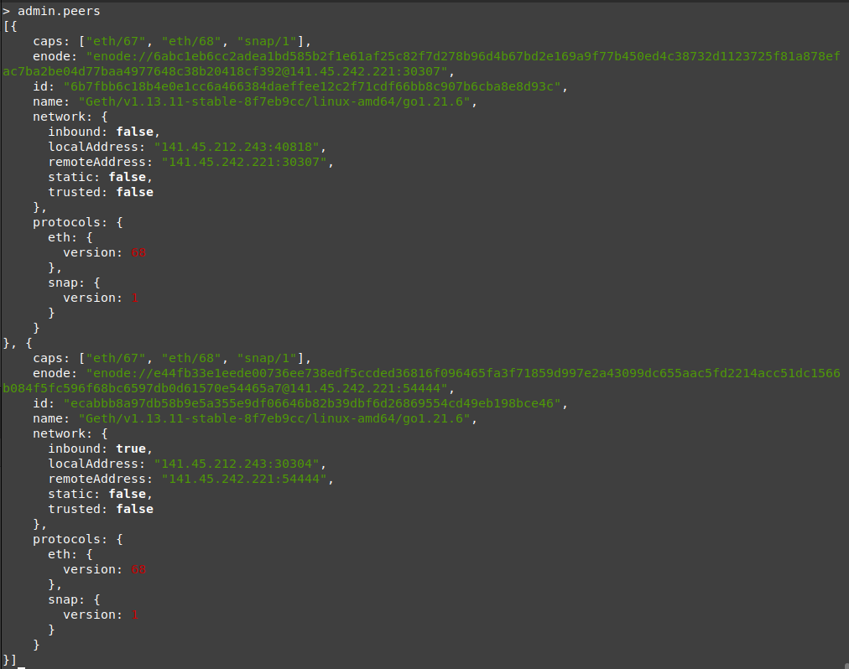
Check connected peers information:
Still from the node1 second terminal window’s JavaScript console, we run the following command: - admin.peers
which will output information about the peers currently connected to this node; we can indeed see two peers information when running it.

Slide 21
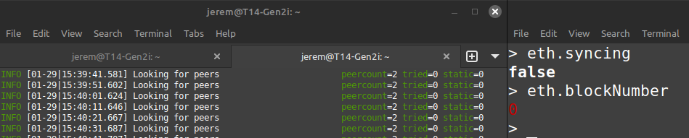
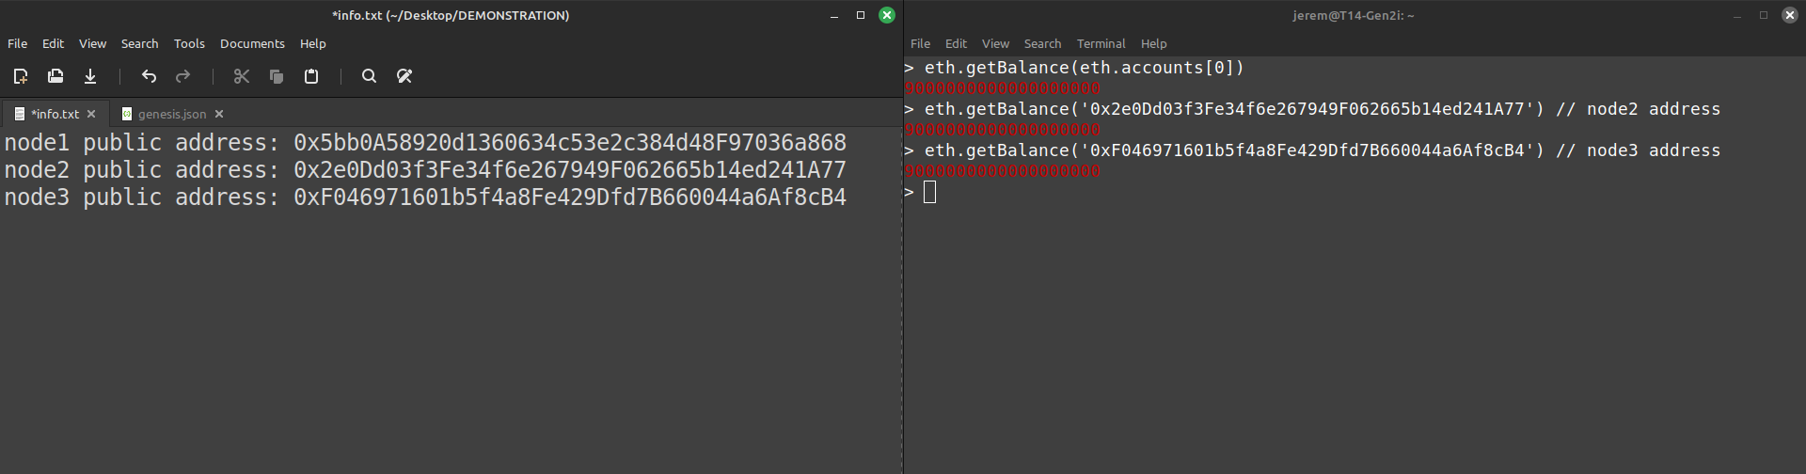
Check synchronization status of the nodes:
From the node1’s JavaScript console again, we should run the two following commands to make sure that all nodes are indeed synchronized to node1:
- eth.syncing that should return false if the nodes are done synchronizing to each other
- eth.blockNumber which should return 0, as we didn’t initiate any transaction yet, and therefore no blocks should have been “minted”:
Check each nodes balances:
From the same console, we will use the eth.getBalance command to check at the balance of our three nodes (which shouldn’t have changed since we didn’t initate any transaction. We can refer to node1 account address by using eth.accounts[0] as it’s the only account present on that node, while for the other two, we refer to their public address:

Slide 22
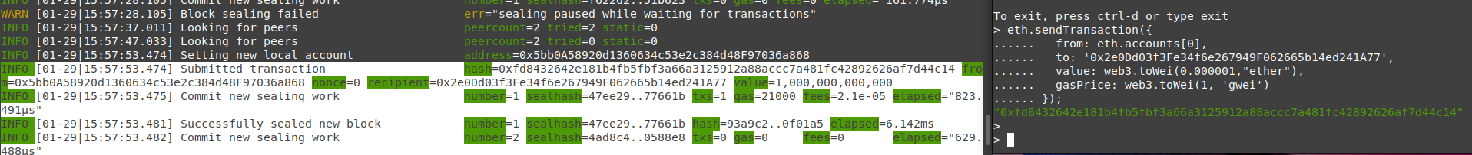
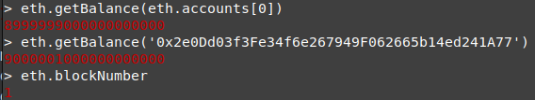
9. Initiate a transaction from node1 to node2:
Still from the node1’s JavaScript console, we’ll initiate a transaction sending 0.000001 Ether to node2 by executing the command on the right of this screenshot: the from field refers to node1’s account, the to field refers to node2’s public address, the value field refers to the amount of Ether to be sent, and the gasPrice value refers to the amount of gas willing to be spent for this transaction.
If successful, we should see a transaction hash appearing as an output (in green), and when checking node1’s logs (or any other running nodes logs), we should see that a transaction has indeed been submitted (where the hash matches the one on the right), and that a new block has been successfully sealed (“Successfully sealed new block - number=1”).
Now, when we check at the balance of both of these accounts, we can see that it has successfully been updated.
Also, when running eth.blockNumber, we can see that 1 new block has been “minted” (or “sealed”).

Slide 23
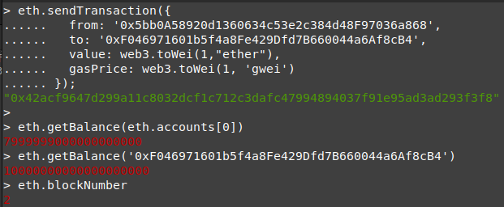
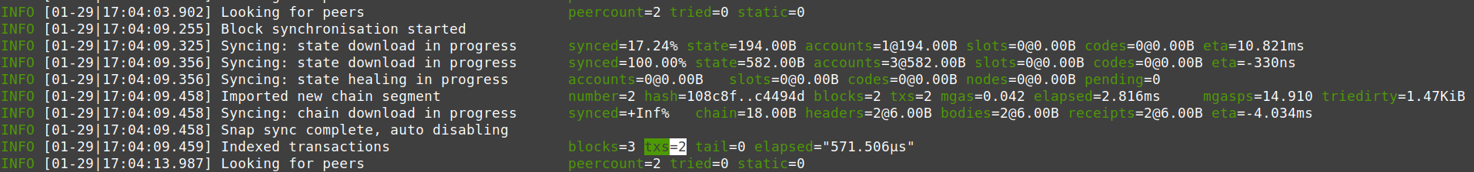
10. Making another transaction from node1 to node3:
We’re now doing the same to execute a transaction from node1 to node3 for a value of 1 Ether:
As expected, we see that the balance of the two accounts have been updated (node3 now has 10 Ether) and that a new block has been sealed (eth.blockNumber returns 2).
When looking at the logs, we can also see that the blockchain is successfully synchronized; indeed, we see that two transactions have successfully been indexed.

Slide 24
THANK YOU!

